Slide 1
MLP Based Intrusion Detection System for Network Traffic
By: Jacque Miller

Slide 2
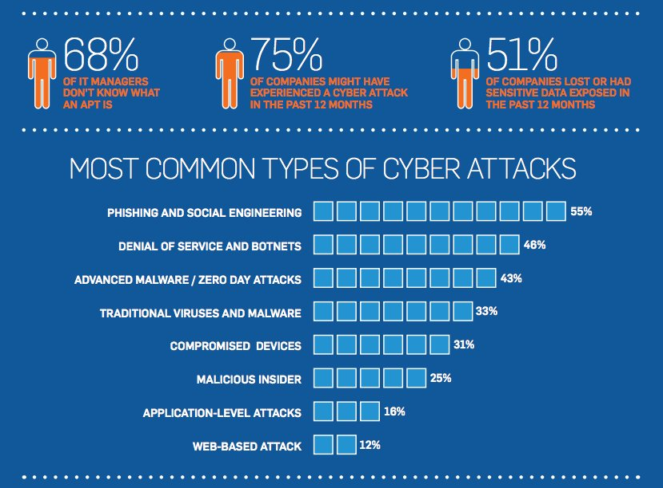
Security & Privacy Issues
Security & Privacy Issues:
Evolving attacks evade rule based systems.
Privacy concerns: Network traffic data often includes sensitive user information, risking leaks during analysis.
Imbalanced datasets lead to biased models favoring normal traffic.

Slide 3
Problem Statement
Problem Statement: Develop an adaptive Intrusion Detection System using a Multi Layer Perceptron neural network to classify network traffic as normal or intrusive, addressing limitations of traditional systems in handling dynamic threats on datasets like NSL-KDD.

Slide 4

Why the Problem is Important?
Prevents data breaches and financial losses
Protects critical infrastructure from evolving threats like DDoS.
Advances ML in cybersecurity, enabling real time detection in growing IoT networks.
Educational value: Demonstrates practical application of neural networks.

Slide 5
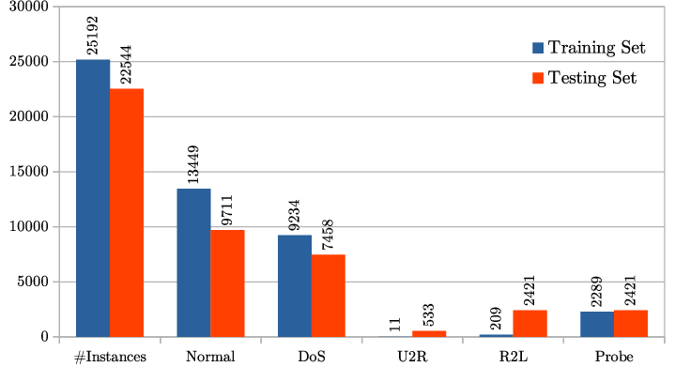
What are the Challenges of the Problem?
Imbalanced data: Normal traffic dominates, leading to biased models.
Real time processing: High computational demands for large scale networks.
Evolving threats: Models must adapt to new attack types without constant retraining.
Overfitting: Neural networks can memorize training data instead of generalizing.

Slide 6
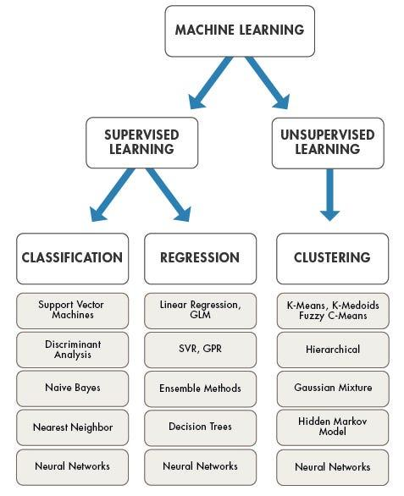
What are the Proposed Solutions by Others?
SVM based IDS: Support Vector Machines for classification.
CNN for traffic analysis: Convolutional Neural Networks treat traffic as images. Which are effective for pattern recognition.
Surveys: "Deep Learning Approaches for Intrusion Detection" by Ferrag et al. (2020).

Slide 7
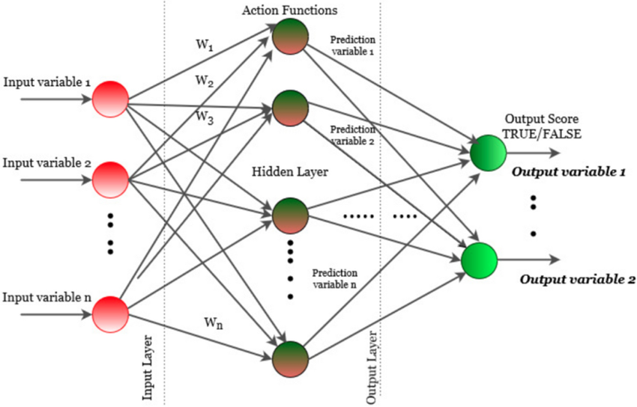
What’s My Solution?
My Solution:
MLP neural network with 2 hidden layers, using scikit-learn's MLPClassifier.
Preprocessing: Label encoding for categoricals, StandardScaler for features, binary classification.
Trained on NSL-KDD dataset.
Hyperparameters: max_iter = 200, random_state = 42.
Evaluation focused on accuracy, precision, recall from confusion matrix.

Slide 8
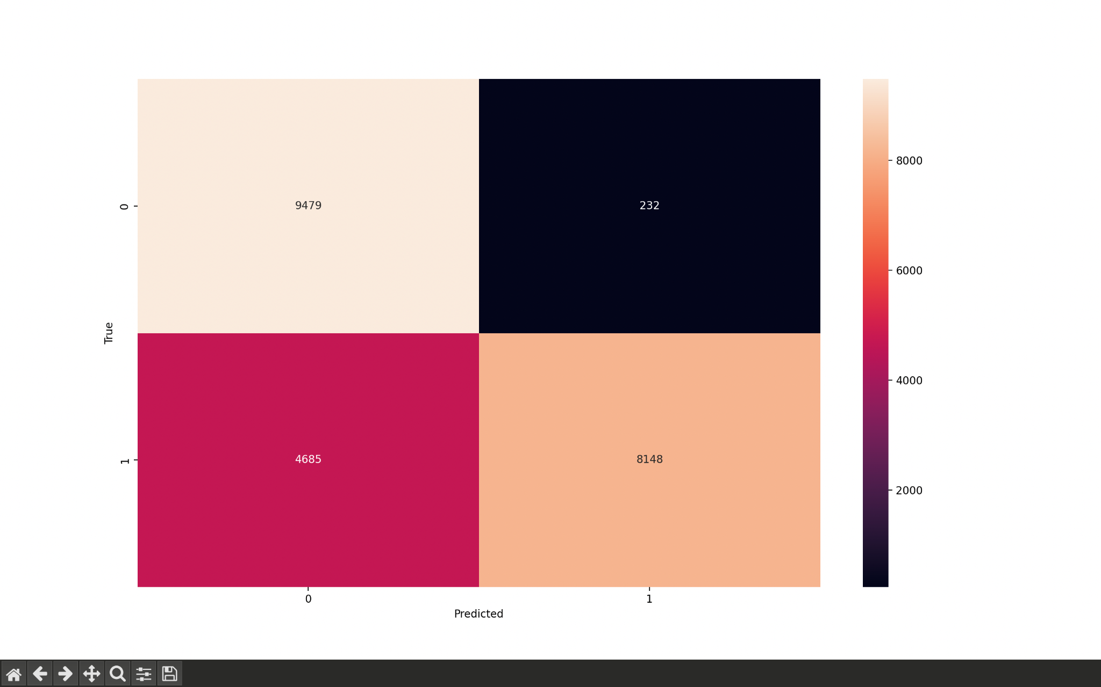

Results
The confusion matrix for the MLP based IDS on the NSL-KDD dataset shows 9,479 true negatives, 232 false positives, 4,685 false negatives, and 8,148 true positives, yielding 0.78 accuracy. This reflects moderate performance with high precision but low recall, likely from dataset imbalance. Improvements like oversampling could enhance detection of rare intrusions while maintaining alert accuracy.
Accuracy: 78% correct classifications on test set.
Precision: 97% of detected attacks were true positives.
Recall: 63% of actual attacks detected.
F1-Score: ~0.77 balanced precision recall.
Outperformed baseline decision tree by ~10% in F1 score.

Slide 9
Conclusions
MLP proved effective for IDS, achieving 0.78 accuracy on NSL-KDD with strong precision.
Addresses key challenges like imbalance from preprocessing.
Limitations: Lower recall indicates room for improvement in detecting rare attacks.
Future Work: Integrate real time streaming add ensemble methods, test on newer datasets like CIC-IDS2017.
Overall: Demonstrates ML's potential in cybersecurity.

Slide 10
References
"A Detailed Analysis of the KDD CUP 99 Data Set" by Tavallaee et al. (2009)
"Intrusion Detection with Neural Networks" by Moradi and Zulkernine (2004)
"Deep Learning Approaches for Intrusion Detection" by Ferrag et al. (2020)
"NSL-KDD Dataset for Network Intrusion Detection" by Tavallaee et al. (2009)
"Machine Learning in Cybersecurity" by Apruzzese et al. (2018)

